Slide 1
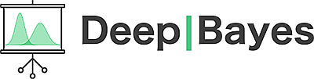
Attention models for deep learning
Michael Figurnov
Researcher at HSE

Slide 2
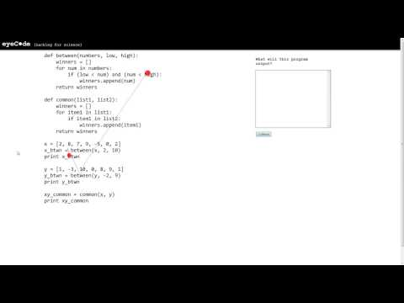
Human attention for reasoning

Slide 3

Why attention in deep learning?
Better interpretability
Faster models
Stronger results
Slide idea: J. Redmon, YOLO 9000 presentation
Picture from wikipedia

Slide 4
Outline
Attention as a latent variable model
Hard & soft attention for image captioning
Training hard attention: REINFORCE, improved methods
Soft attention for image captioning
Soft attention for neural machine translation
With LSTMs
Or without! Attention Is All You Need!
Soft attention for image classification
Spatial Transformer Networks

Slide 5
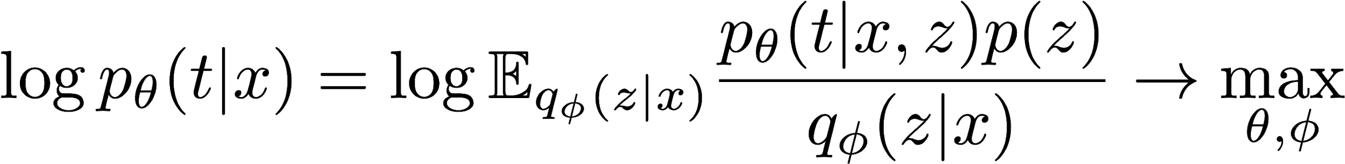
Attention as a latent variable
Discriminative model
input x
label t
latent variable z (continuous or discrete)
parameters 𝜃
Training: maximum likelihood, intractable
Alternative model:
approximate posterior = prior
approximate posterior != prior

Slide 6
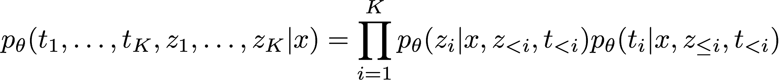
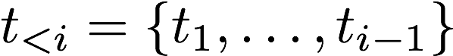
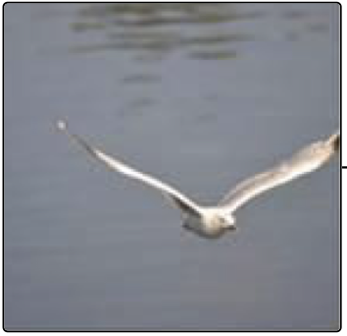
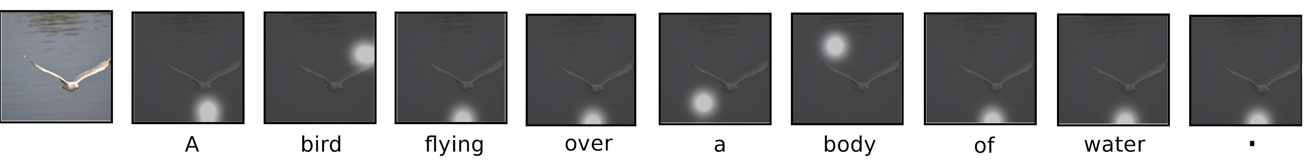
Attention for image captioning
Image x: L positions, D features in each
Generate K words t₁, ..., t_{K}
Latent variable for each word
Discrete distribution over L positions
Discriminative model
Xu et al. “Show, Attend and Tell: Neural Image Caption Generation with Visual Attention” ICML 2015

Slide 7
Outline
Attention as a latent variable model
Hard & soft attention for image captioning
Training hard attention: REINFORCE, improved methods
Soft attention for image captioning
Soft attention for neural machine translation
With LSTMs
Or without! Attention Is All You Need!
Soft attention for image classification
Spatial Transformer Networks

Slide 8
Hard & soft attention
Hard
Attention as stochastic process; sampling
Supports discrete decisions (number of steps)
Training with REINFORCE
Soft
Attention as differentiable layer
No sampling
Training with backprop

Slide 9
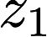
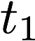
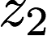
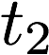
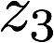
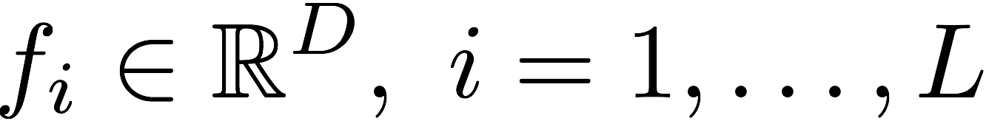
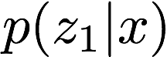
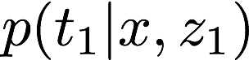
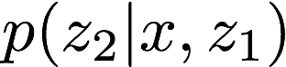
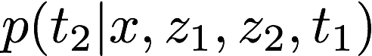
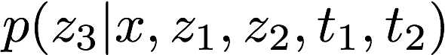
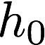
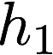
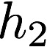
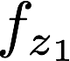
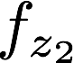
Hard attention for image captioning
a
bird
position to attend
sample
D features
L positions
...
convnet
features for position z₁
features for position z₂
Xu et al. “Show, Attend and Tell: Neural Image Caption Generation with Visual Attention” ICML 2015

Slide 10
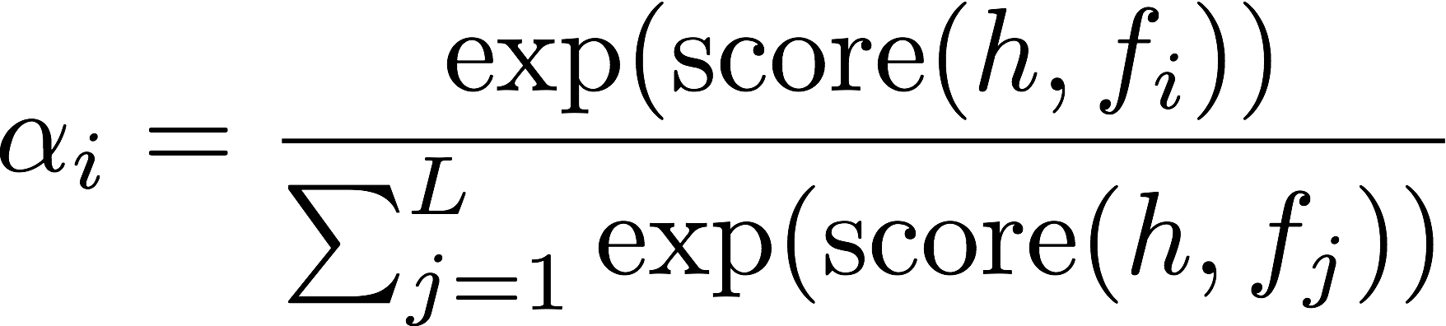
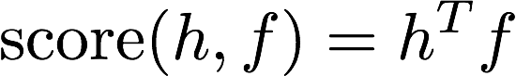
Choosing the latent variable probabilities
Many ways to compute the score
Image captioning uses additive attention
additive attention
dim(h) != dim(f)
[1]
multiplicative attention
dim(h) = dim(f)
[2]
[3]
[1] Bahdanau et al. "Neural Machine Translation by Jointly Learning to Align and Translate", 2014
[2] Luong et al. "Effective approaches to attention-based neural machine translation", 2015
[3] Vaswani et al. "Attention Is All You Need", 2017

Slide 11
Outline
Attention as a latent variable model
Hard & soft attention for image captioning
Training hard attention: REINFORCE, improved methods
Soft attention for image captioning
Soft attention for neural machine translation
With LSTMs
Or without! Attention Is All You Need!
Soft attention for image classification
Spatial Transformer Networks

Slide 12
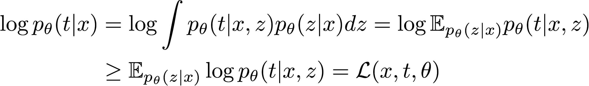
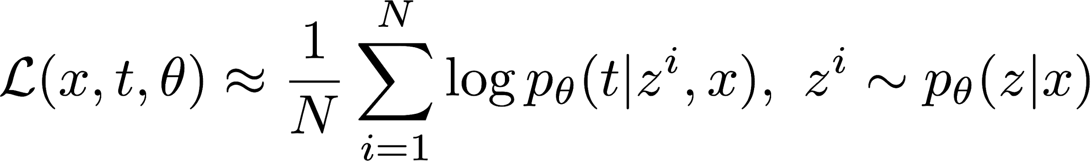
Training hard attention
Training objective: evidence lower bound
Monte-Carlo sampling: unbiased estimate of the objective
REINFORCE for computing the gradients

Slide 13
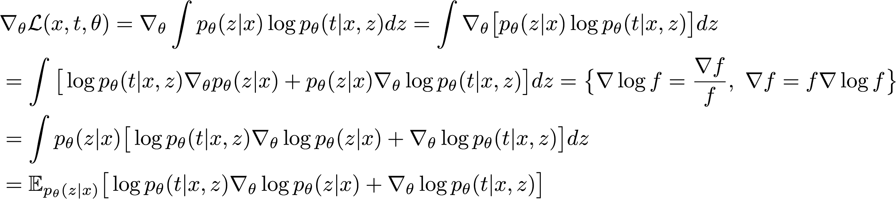
Computing gradients with REINFORCE
log-derivative trick
strategy/policy
reward
The expectation can be approximated by Monte-Carlo sampling! Unbiased! But very high variance → hard to train :(

Slide 14
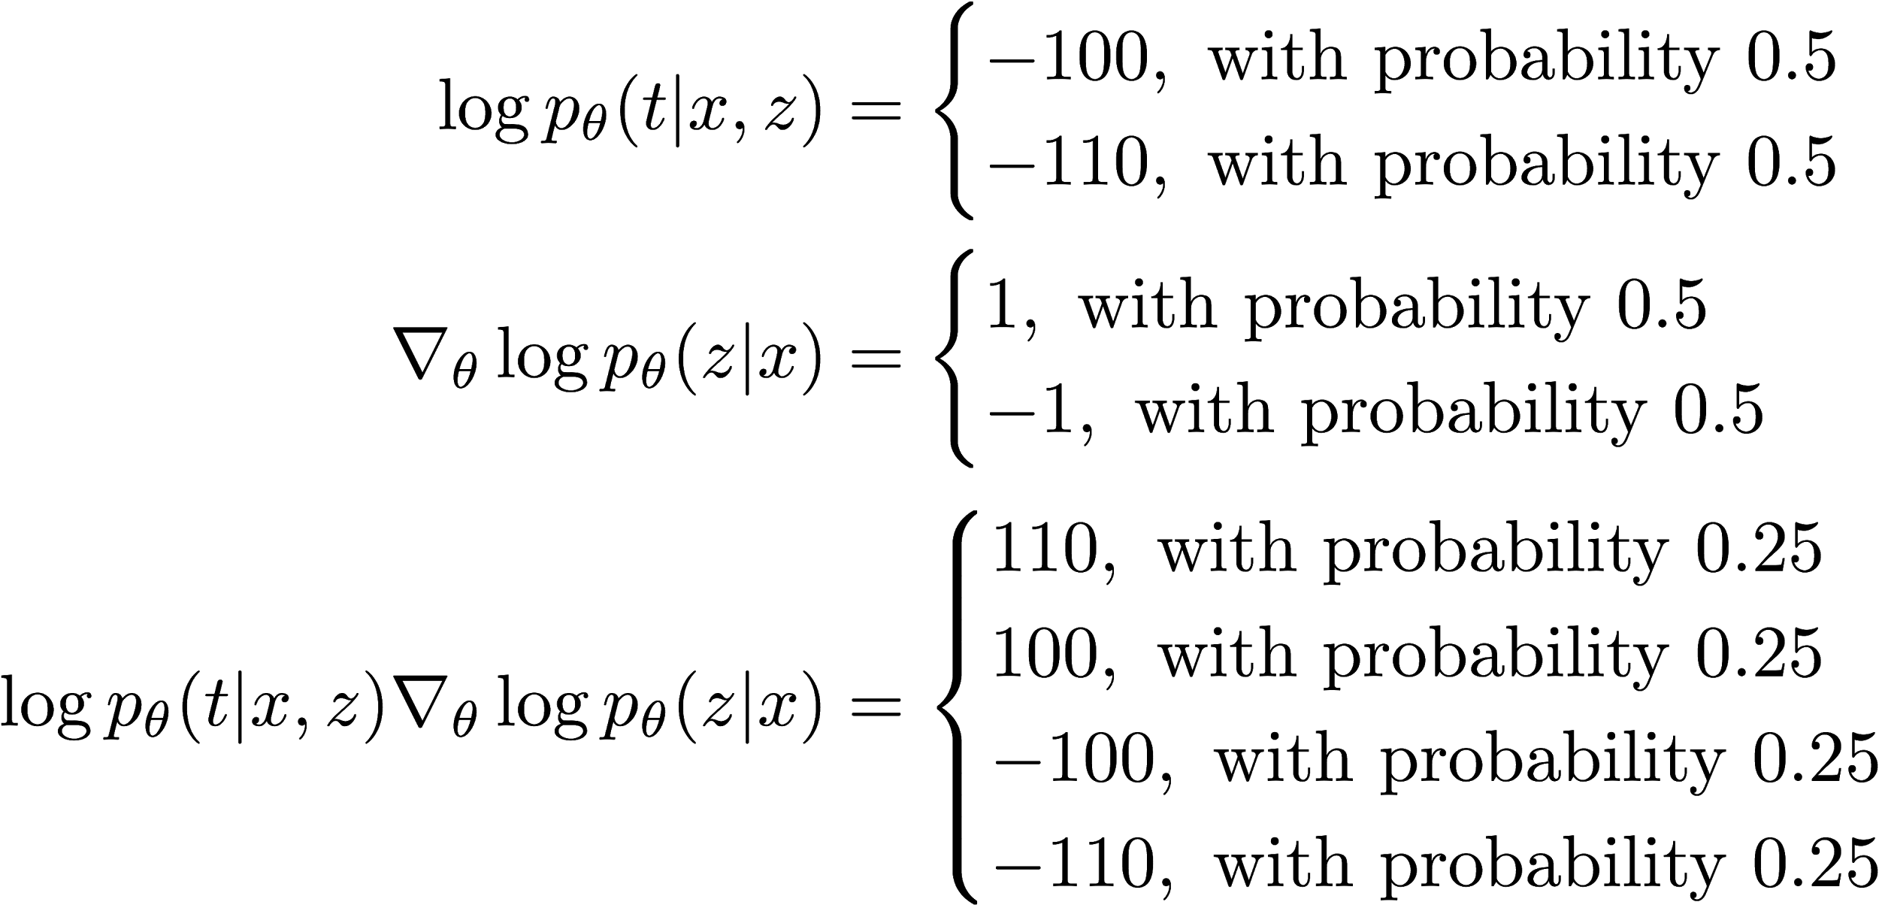
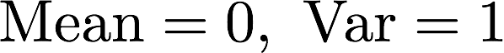
Why is the variance high?
Notes:
Question: why is the mean of reward * grad log p(z|x) = 0?

Slide 15
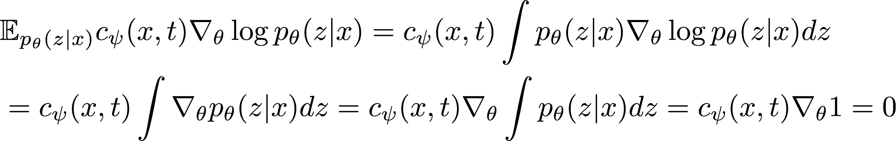
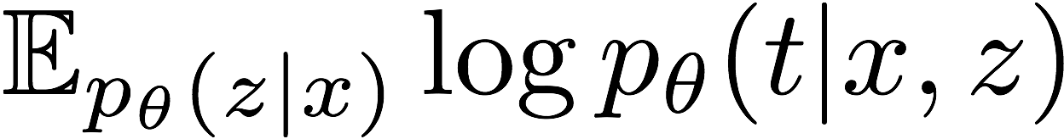
Reward baselines
reward baseline
Requirement for a good baseline:
c is a constant, an exponential moving average of
Neural network as a baseline

Slide 16
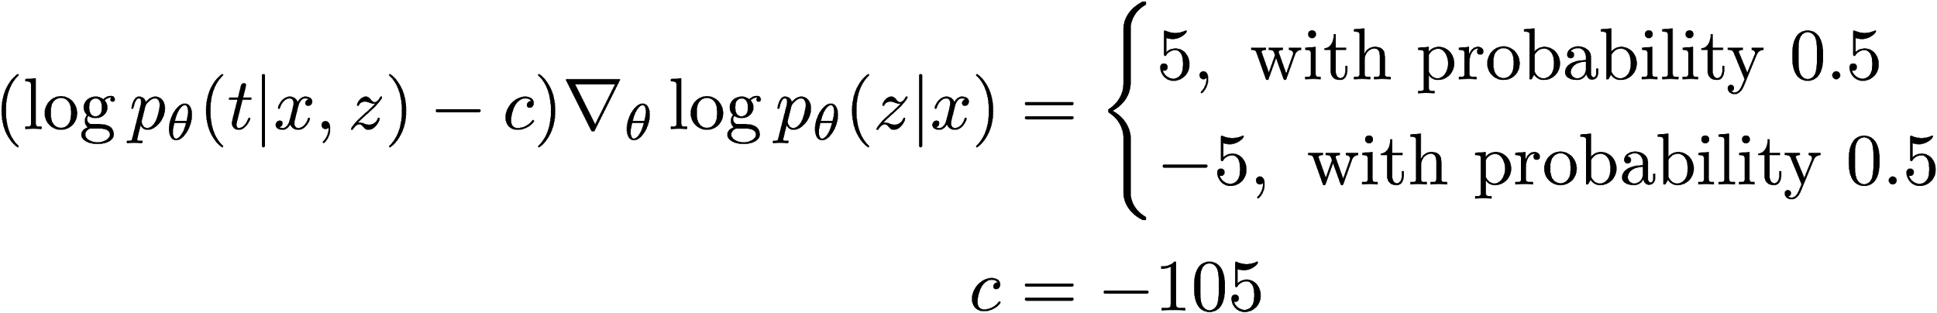
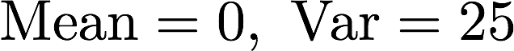

Revisit the example

Slide 17
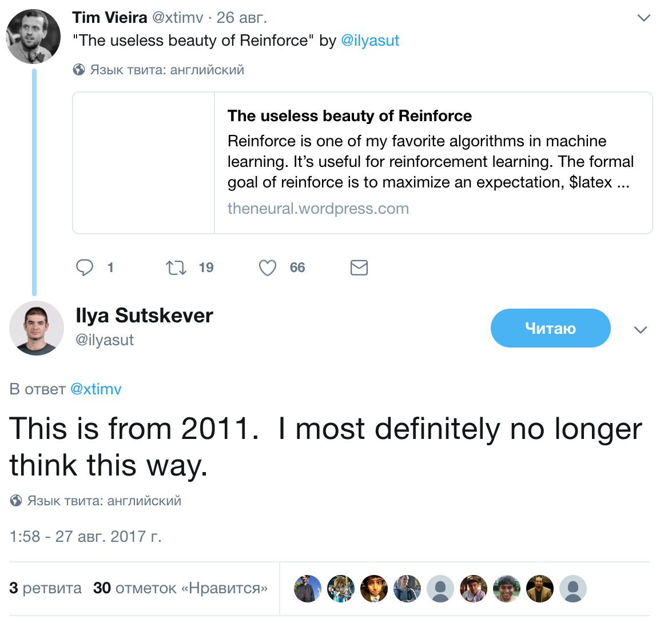

Slide 18
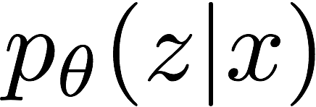
Techniques to improve training of hard attention
Use ADAM optimizer
Automatically normalizes the variance of the gradients
Replace the reward with something low-variance
For classification: 1 for correct label, 0 otherwise (instead of correct label log-likelihood)
Introduces bias :(
Add entropy of to the objective
Avoid "overly confident" strategies
Connection to variational inference

Slide 19
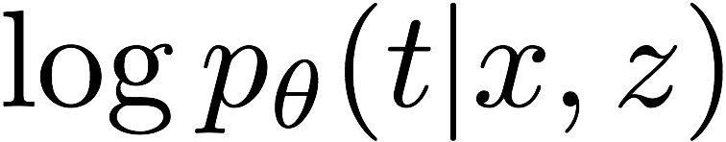
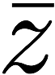
Lower-variance alternatives to REINFORCE
MuProp
Idea: in many cases we can compute
Baseline: first-order Taylor expansion of around
Variational Inference for Monte-Carlo Objectives
Take k samples of the latent variable
For any sample, the average reward over other samples is a great baseline!
Importance-weighted lower bound (better than evidence lower bound)
Gu et al. "MuProp: Unbiased backpropagation for stochastic neural networks", 2016
Mnih, Rezende "Variational inference for Monte Carlo objectives", 2016

Slide 20
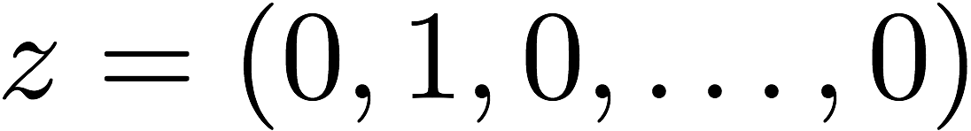
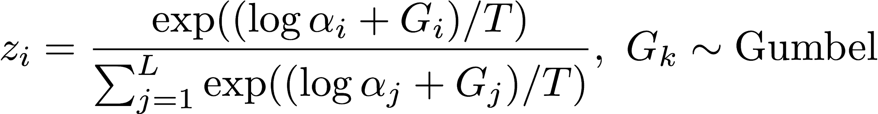
Gumbel-Softmax / Concrete distribution
Replace discrete random variable with a continuous one
Reparameterization trick
Low-variance, but biased gradients
one-hot vector
Available in TensorFlow
tf.contrib.distributions.RelaxedOneHotCategorical
Jang et al. "Categorical reparameterization with Gumbel-Softmax", 2017
Maddison et al. "The concrete distribution: A continuous relaxation of discrete random variables", 2017

Slide 21
Outline
Attention as a latent variable model
Hard & soft attention for image captioning
Training hard attention: REINFORCE, improved methods
Soft attention for image captioning
Soft attention for neural machine translation
With LSTMs
Or without! Attention Is All You Need!
Soft attention for image classification
Spatial Transformer Networks

Slide 22

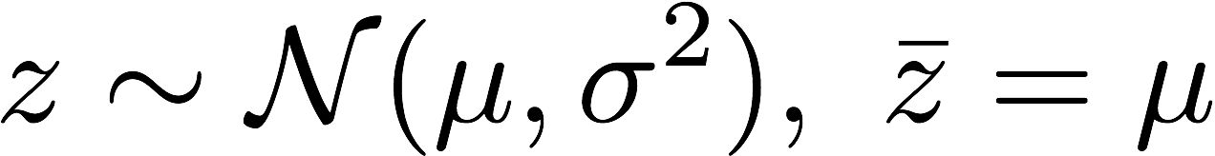
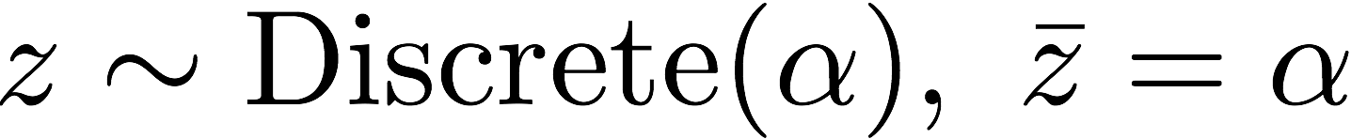
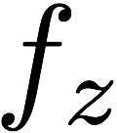
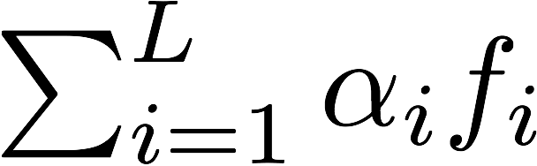
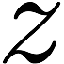
Soft attention
Can we remove sampling altogether?
Replace with
Not always possible :( For example, when dimensions of depend on
Deterministic graph with differentiable operations, train with backprop

Slide 23
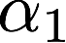
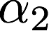
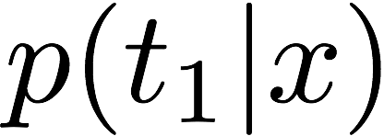
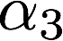
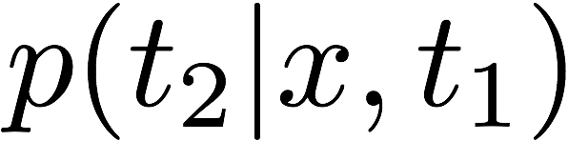



Soft attention for image captioning
a
bird
D features
L positions
...
convnet
weighted average of features
Xu et al. “Show, Attend and Tell: Neural Image Caption Generation with Visual Attention” ICML 2015
Notes:
Add "doubly stochastic attention" slide? (enforce that the model looks at every position during the text generation)

Slide 24


Introspection via soft attention
Xu et al. “Show, Attend and Tell: Neural Image Caption Generation with Visual Attention” ICML 2015

Slide 25


Soft vs. hard attention
Hard attention
Better results (sometimes?)
More principled
Hard to train
Soft attention
Not always applicable
Easy to train
soft
hard
Xu et al. “Show, Attend and Tell: Neural Image Caption Generation with Visual Attention” ICML 2015

Slide 26
Outline
Attention as a latent variable model
Hard & soft attention for image captioning
Training hard attention: REINFORCE, improved methods
Soft attention for image captioning
Soft attention for neural machine translation
With LSTMs
Or without! Attention Is All You Need!
Soft attention for image classification
Spatial Transformer Networks

Slide 27
Neural machine translation and long sentences
Early in the year 1806 Nicholas Rostov returned home on leave. <EOS>
decoder
1000 numbers
encoder
В начале 1806 года Николай Ростов вернулся в отпуск. <EOS>
Leo Tolstoy "War and Peace", 1869

Slide 28


Neural machine translation and long sentences
Meeting a comrade at the last post station but one before Moscow, Denisov had drunk three bottles of wine with him and, despite the jolting ruts across the snow-covered road, did not once wake up on the way to Moscow, but lay at the bottom of the sleigh beside Rostov, who grew more and more impatient the nearer they got to Moscow. <EOS>
decoder
1000 numbers
encoder
На предпоследней станции, встретив товарища, Денисов выпил с ним три бутылки вина и подъезжая к Москве, несмотря на ухабы дороги, не просыпался, лежа на дне перекладных саней, подле Ростова, который, по мере приближения к Москве, приходил все более и более в нетерпение. <EOS>
Leo Tolstoy "War and Peace", 1869
Cho et al. "On the Properties of Neural Machine Translation: Encoder-Decoder Approaches", 2014

Slide 29
Outline
Attention as a latent variable model
Hard & soft attention for image captioning
Training hard attention: REINFORCE, improved methods
Soft attention for image captioning
Soft attention for neural machine translation
With LSTMs
Or without! Attention Is All You Need!
Soft attention for image classification
Spatial Transformer Networks

Slide 30


Soft attention for neural machine translation
meeting
a
with attention
...
encoder LSTM states
without attention
на предпоследней станции встретив товарища
Bahdanau et al. "Neural Machine Translation by Jointly Learning to Align and Translate", 2014

Slide 31


Attention maps in translation
source language (English)
source language (English)
target language (French)
target language (French)
Bahdanau et al. "Neural Machine Translation by Jointly Learning to Align and Translate", 2014

Slide 32
Outline
Attention as a latent variable model
Hard & soft attention for image captioning
Training hard attention: REINFORCE, improved methods
Soft attention for image captioning
Soft attention for neural machine translation
With LSTMs
Or without! Attention Is All You Need!
Soft attention for image classification
Spatial Transformer Networks

Slide 33

Attention Is All You Need
Replace LSTMs with a lot of attention! Apply to neural machine translation
State-of-the art results
Much less computation for training
Vaswani et al. "Attention Is All You Need", 2017

Slide 34
Layer types
Input layer
Per-word feedforward
Self-attention
Attention over encoder outputs
Vaswani et al. "Attention Is All You Need", 2017

Slide 35
Input layer
add positional encoding
encode offsets between words not used in LSTMs
embedding
pick a vector for every word
на предпоследней станции встретив товарища
Vaswani et al. "Attention Is All You Need", 2017

Slide 36
Per-word feedforward
fully-connected network same for every word
G(x) = Dense(ReLU(Dense(x)))
...
на предпоследней станции встретив товарища
Vaswani et al. "Attention Is All You Need", 2017

Slide 37



Self-attention
every word attends to features of all words
replaces recurrence
...
Multi-head attention: apply attention in K feature spaces; concatenate results
на предпоследней станции встретив товарища
Vaswani et al. "Attention Is All You Need", 2017
Notes:
Multi-head attention can be implemented efficiently using projection matrices

Slide 38




Attention over encoder outputs
depends on
every word attends to features of words from the original sentence
same as soft attention in Neural Machine Translation with LSTM
...
...
meeting a
на предпоследней станции
encoder
decoder
Vaswani et al. "Attention Is All You Need", 2017

Slide 39

Attention Is All You Need model
meeting
a
comrade
...
encoder output
...
feed-forward
feed-forward
attention
x6
x6
masked
self-attention
self-attention
input layer
input layer
<start>
на предпоследней станции
encoder
decoder
Notes:
Also, residual connections, layer normalization, dropout...

Slide 40


What do the self-attention heads look at?
attention head #1
attention head #2
layer 5
weights
layer 6
layer 5
weights
layer 6
Vaswani et al. "Attention Is All You Need", 2017

Slide 41
Outline
Attention as a latent variable model
Hard & soft attention for image captioning
Training hard attention: REINFORCE, improved methods
Soft attention for image captioning
Soft attention for neural machine translation
With LSTMs
Or without! Attention Is All You Need!
Soft attention for image classification
Spatial Transformer Networks

Slide 42





Spatial Transformer Networks
Latent variable
Crop a patch defined by z
Naive way: hard attention, REINFORCE
Recurrent Attention Model, 2014
Smart way: soft attention, backprop Realize that bilinear interpolation is differentiable!
Spatial Transformer Networks, 2015
Mnih et al. "Recurrent Models of Visual Attention", 2014
Jaderberg et al. "Spatial Transformer Networks", 2015

Slide 43



Differentiable bilinear interpolation
Compute a value at a real-valued position
U is 2D image, v is bilinearly interpolated value
Jaderberg et al. "Spatial Transformer Networks", 2015
Bilinear interpolation visualization: wikipedia

Slide 44


Spatial Transformer Network
Convolutional neural network layer
bilinear interpolation
Jaderberg et al. "Spatial Transformer Networks", 2015

Slide 45

Bird classification using spatial transformers
Higher resolution
→ better accuracy
process at 224px
Jaderberg et al. "Spatial Transformer Networks", 2015

Slide 46


Bird classification using spatial transformers
Jaderberg et al. "Spatial Transformer Networks", 2015

Slide 47



Spatially Adaptive Computation Time
Learn to adjust the number of layers in a convolutional network
Faster and more interpretable model
Kind of soft attention
Image with detections
Number of layers
Figurnov et al. "Spatially Adaptive Computation Time", 2017

Slide 48
Conclusion
Attention allows to improve deep learning
Better interpretability
Faster models
Stronger results
Attention parameters are latent variables
Hard vs. soft attention
Hard attention is more principled
Soft attention is easier to train
Hard attention training methods are improving
Useful for image captioning, machine translation, image classification, ...
Can attention be used to create much faster models?

Slide 49

Spatial Transformer Networks
Jaderberg et al. "Spatial Transformer Networks", 2015

Slide 50


Attend, Infer, Repeat
Variational auto-encoder for multiple objects per image
Latent variables
Number of objects
Positions of objects
Descriptions of objects
encoder
(inference)
latent
variables
decoder (generator)
Eslami et al. "Attend, Infer, Repeat", 2016

Slide 51


Generative model
Eslami et al. "Attend, Infer, Repeat", 2016

Slide 52


Generative model
VAE
Attend, Infer, Repeat
number of objects
spatial transformer parameters
VAE code
Eslami et al. "Attend, Infer, Repeat", 2016

Slide 53




Inference model
VAE
Attend, Infer, Repeat
Eslami et al. "Attend, Infer, Repeat", 2016

Slide 54










Implementing the model
sample
VAE
ST
sample
ST
sample
Eslami et al. "Attend, Infer, Repeat", 2016

Slide 55

Learning the parameters
Evidence lower bound
Training z: reparameterization trick
Training z_{present}: REINFORCE
Eslami et al. "Attend, Infer, Repeat", 2016

Slide 56

Video
Eslami et al. "Attend, Infer, Repeat", 2016

Slide 57

Estimating the number of digits
AIR requires much less training data than CNN
Recurring theme in machine learning: better prior = less data necessary
Eslami et al. "Attend, Infer, Repeat", 2016

Slide 58
Recurrent Models of Visual Attention

Slide 59

Human attention for 3D navigation

Slide 60

Scaled soft attention layer
Queries matrix Q, N x d (multiple queries at once!)
Keys matrix K, M x d
Values matrix V, M x D
We will use K = V
scaling
Query Q
question
00..000
Key K Value V
question
answer
Vaswani et al. "Attention Is All You Need", 2017

Slide 61


Multi-head attention
Concatenate outputs of several soft attention layers
Use projection layers to save computation
V
K
Q
Vaswani et al. "Attention Is All You Need", 2017

Slide 62
Attention Is All You Need model
Residual connection + layer normalization
6x
6x
Vaswani et al. "Attention Is All You Need", 2017
encoder
decoder

Slide 63
Outline
Hard + soft attention for generative image model
Attend, Infer, Repeat

